Slide 1
ISM 6562 Data Visualization
Group Project
Movie Data Analysis: Studying the factors of success and other meaningful
patterns in the world of commercial cinema
Team 5
April 18th, 2022
Nico Mora
Sathvik ganta
Denise collins
Narottam jajodia
Sage ramsammy
Notes:
LT: Hello everyone, thank you for joining us today. We are the UF team and we are looking forward to you speaking about making an impact towards low income low access communities.

Slide 2
Visualization Goals
Questions to Answer:
Which factors determine a movie’s success?
How does the share of genres/age rating change over time?
Do movie releases cluster within certain periods of a year?
Can we visualize company / director relevancy in the movie industry over-time?
Which are the top 15 countries based on movie profit rate?
Collected Data
Kaggle Dataset - Movie Industry
There are 6820 movies in the dataset (220 movies per year, 1986-2016)
This data was scraped from IMDb
https://www.kaggle.com/datasets/danielgrijalvas/movies
Notes:
LT:
There is a difference if we need to either predict these LILA communities than to define what a LILA community is. The USDA has already stated what motives dictate a community. But if we are currently facing a classification change of 9.5% in census tracts, it is important to understand how and why these changes are occurring.
Our current model has been able to predict 78.5% of these LILA communities, whether they are considered low income and/or low access, and how are we able to predict these outcomes. This model is aligning the census count as well as LILA information through standardizing the time gap, and we are focused in on how to allocate our capital efficiently to help these communities from food insecurity. With where our model stands as well as making incremental improvements, we are looking to drive impact, create food and nutrition policies, as well as promote nutrition education.

Slide 3
Design process
Q1: Which factors determine a movie’s success?
Visualization 1
‘Study Finds Big-Budget Movies Make Greater Profits’. (The Wrap, 2009)
Aims to study the relationship between profits made by a movie and factors like: Budget, IMDb rating, and Runtime. Uses scatter plots to try and identify if any of these factors has a significant relationship with Profit. This relationship could also be causal in nature. This analysis could help producers focus on certain aspects to ensure maximum returns.
Visualization 2
Aims to study the impact that certain genres have on profits, based on their release month. This may help us understand if certain genres attract higher profits if released in certain months of the year. The Y-axis is average profits per movie in that genre-month.

Slide 4
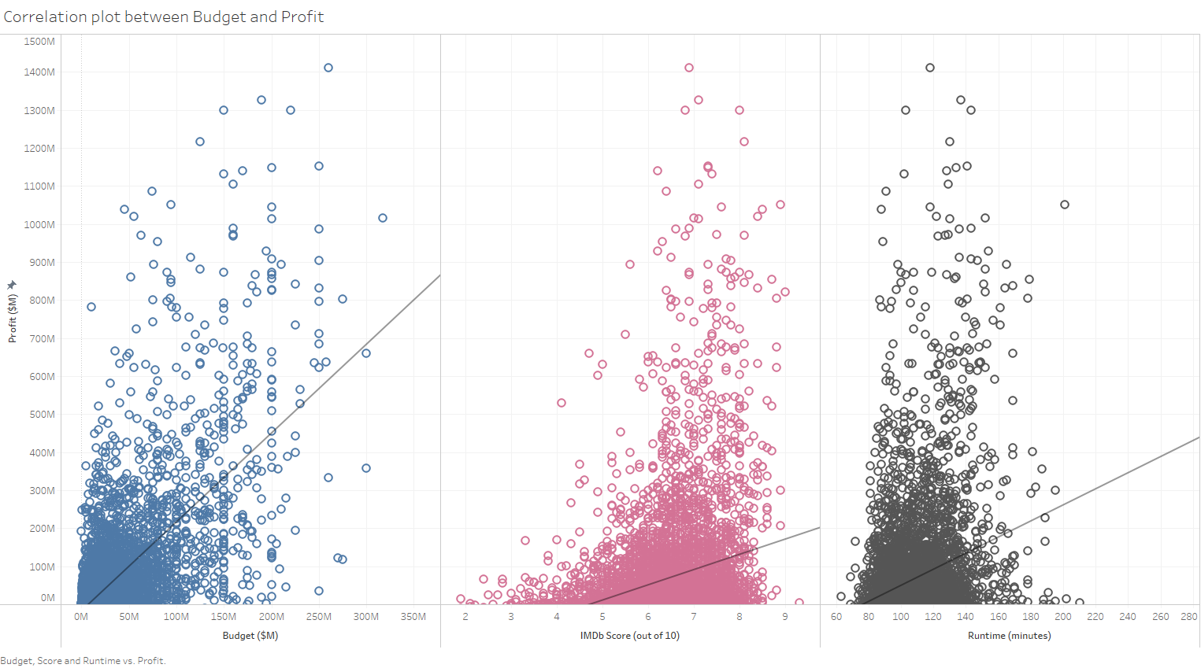
Final visualization
Profit analysis through other factors
Budget seems to have the strongest positive relationship with Profits.
Runtime and IMDb score are also positively related.
No causal relationship can be determined

Slide 5
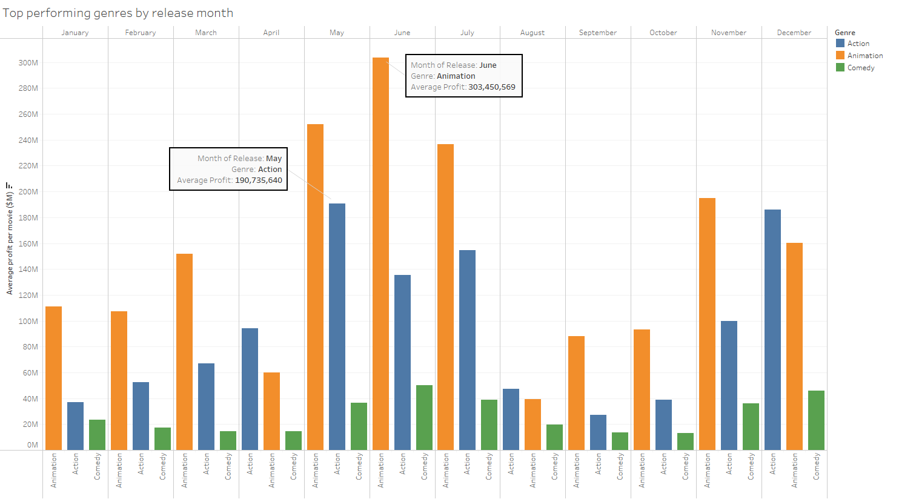
Final visualization
Profit analysis through other factors
Adults like animation too. (The Hindu, 2015)
Animation movies seem to make the most profits throughout the year.
This could be because animation movies generally require low budget but attract children & adults equally.
The animation genre is most prominent in May-July and least in August.
Action movies make the most profits in May and December. Comedy is the 3rd most popular genre.

Slide 6
Design process
Q2: How does the share of genres/age rating change over time?
Visualization 1
Aimed to visualize the count of Genres in the movie industry across time to see if we could discover characteristics, patterns, or trends of this industry.
Visualization 2
Similarly, this visualization displays the count of Ratings in the movie industry across time to see if we could discover characteristics, patterns, or trends of this industry.

Slide 7
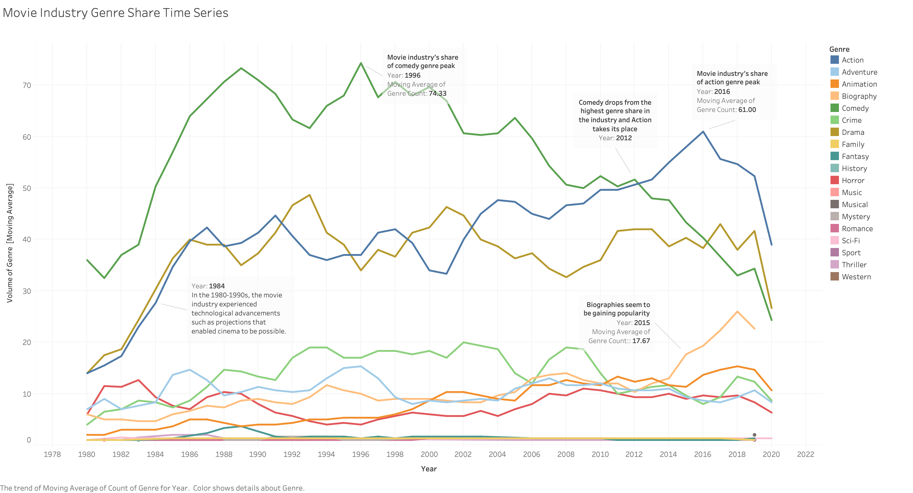
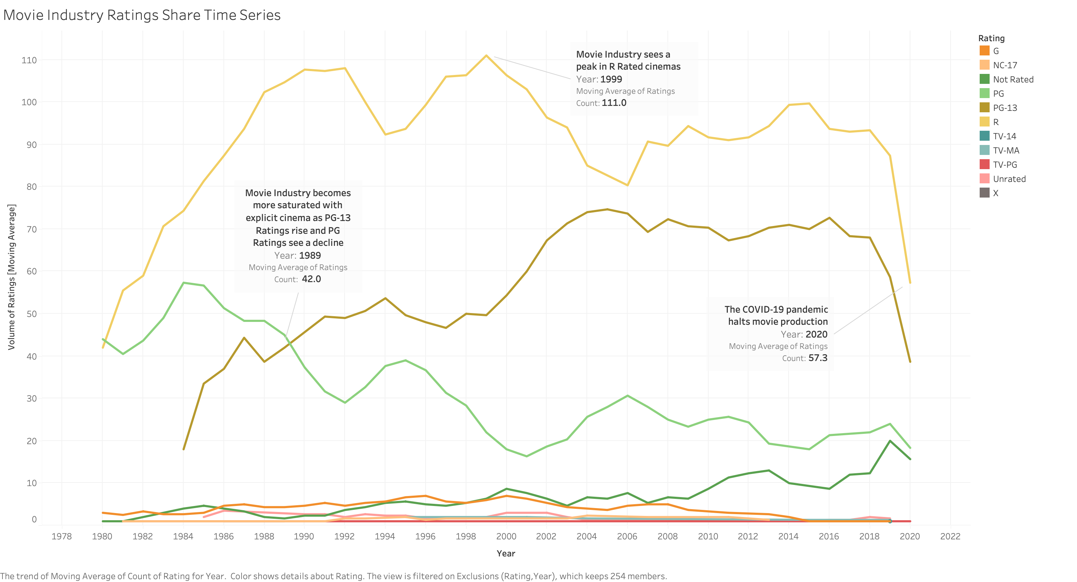
Final visualization
Movie Industry Genre and Ratings Share Time Series’
Movie Industry Genre Share Time Series
Rapid growth in the movie industry during the 1980s through the 1990s due to technological advancements such as movement dissection and film cameras.
In 2012 the top Genre for the movie industry change from Comedy to Action.
In 2014 we saw a spike in production for Biographies within the movie industry.
Movie Industry Ratings Share Time Series
In 1989 through 2004, the movie industry became saturated with PG-13 movies as high-grossing cinemas like Batman Returns and Titanic influenced production companies.
Rated R movies have led the movie industry since the 1980s.
The COVID-19 pandemic lockdowns lowered the count of movies in 2020.

Slide 8
Design process
Q3: Do movie releases cluster within certain periods of a year?
Visualization 1
To fully understand whether movies cluster, we first decided to see the data as a whole. Through this, we could detect any consistent markings over time. A line graph depicting the revenue based on the year released was first implemented.
Visualization 2
This visualization focuses on years 2015-2019. The years 2020 and 2021 were filtered out due to the number of nulls. Here, we will be able to see the most popular months and seasons. We chose to look at the data by months to see granular trends.

Slide 9
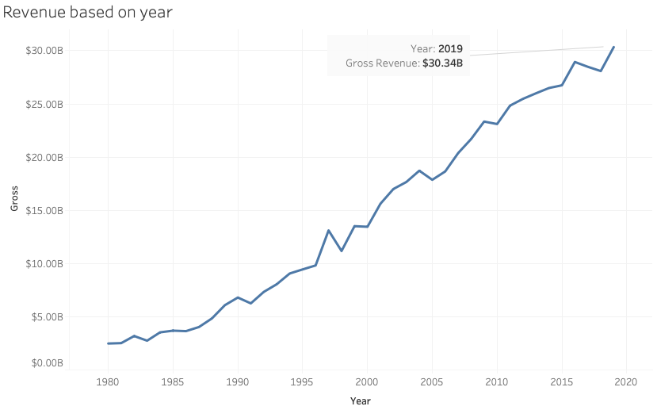
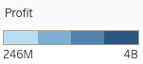
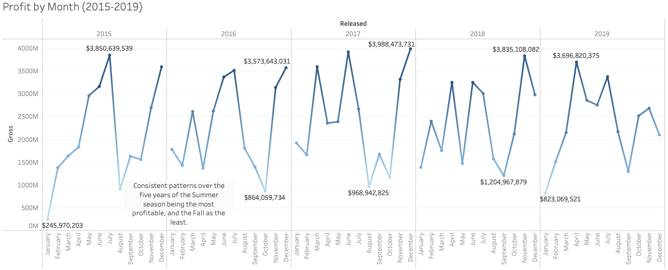
Final visualization
Revenue Based on Year & Profit by Month
The revenue for the movie industry is increasing steadily. However, it was evident that there were no visible patterns over the time frame of the data aside from this.
The seasons most movies are released are the Summer and Winter, and the least amount being Fall. Profitability seasons vary by year, with all five years having the Summer or Winter season as their most profitable and the Fall as the least.

Slide 10
Design process
Q4: Can we visualize company/director relevancy in the movie industry based on Score?
Visualization 1
Firstly, in order to understand the relation between them we need to understand how the scoring occurs based on the number of people voting for a movie. To understand score vs votes relation, we plot score and votes.
Visualization 2:
Once we understand the relation between score and votes our next task was to see how it would be relevant to the director and industry. In this visualization we focus on how a director and a production company are relevant based on their votes and score.

Slide 11
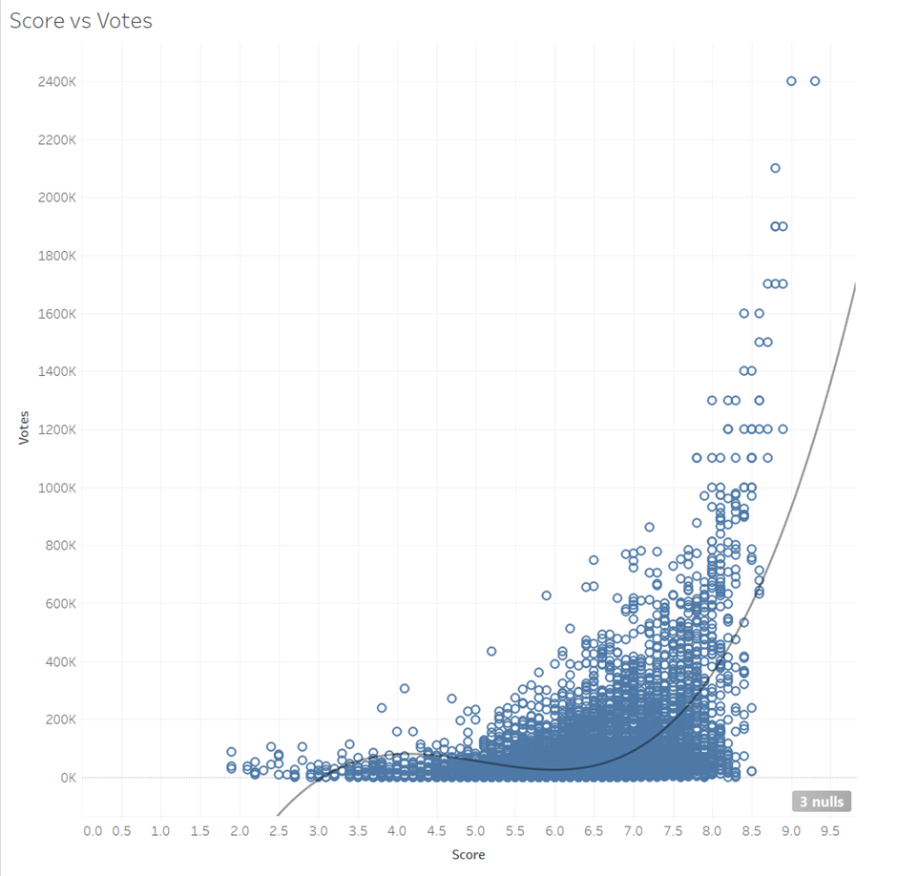
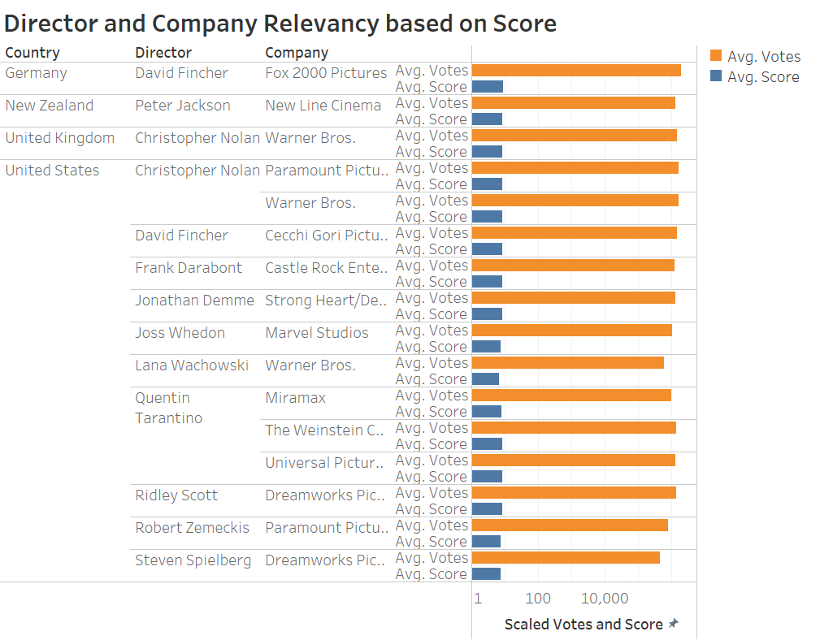
Final visualization
Relevancy based on Score
We see the score increases polynomially based on the votes.
The scores between 1.5 and 7.5 received almost less than half a million votes.
We see the most relevant director and production company combination.
USA has the most relevant combinations as per its popularity compared to other countries.

Slide 12
Design process
Q5: Which country has the greatest profits?
Visualizations 1 and 2
The purpose of the visualizations is to visualize the average profits and total profits of the top fifteen countries of the dataset. Tables can be the most effective visualization to display certain data, and this was chosen as the best option for the data provided.
Visualization 3
The visualization aims to display the profits of countries around the world and see which areas have the greatest concentration of total profits. A global heat map was chosen to see where in the world, the movie industries are most profitable.
Visualization 4
The aim of this visualization is to see the difference in the average profits of the countries compared to one another. A bar graph was chosen to most easily compare categorical and continuous variables.

Slide 13
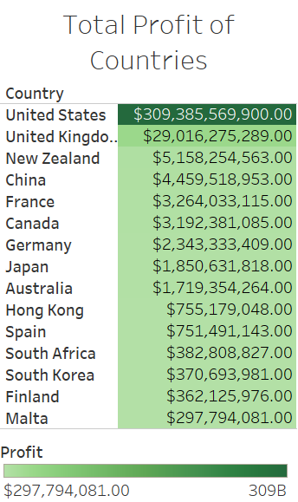
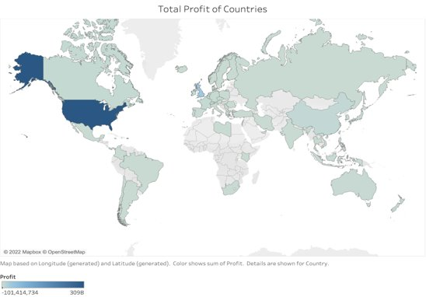
Final visualization
Total Profit of Countries
United States leads in total profits by a large margin compared to other countries. It is also interesting to see that the top five countries for total profit are on four different continents.

Slide 14
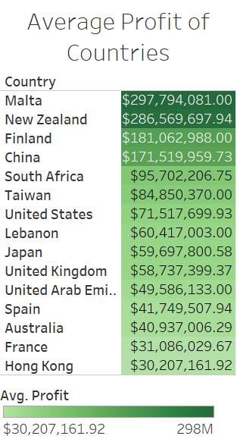
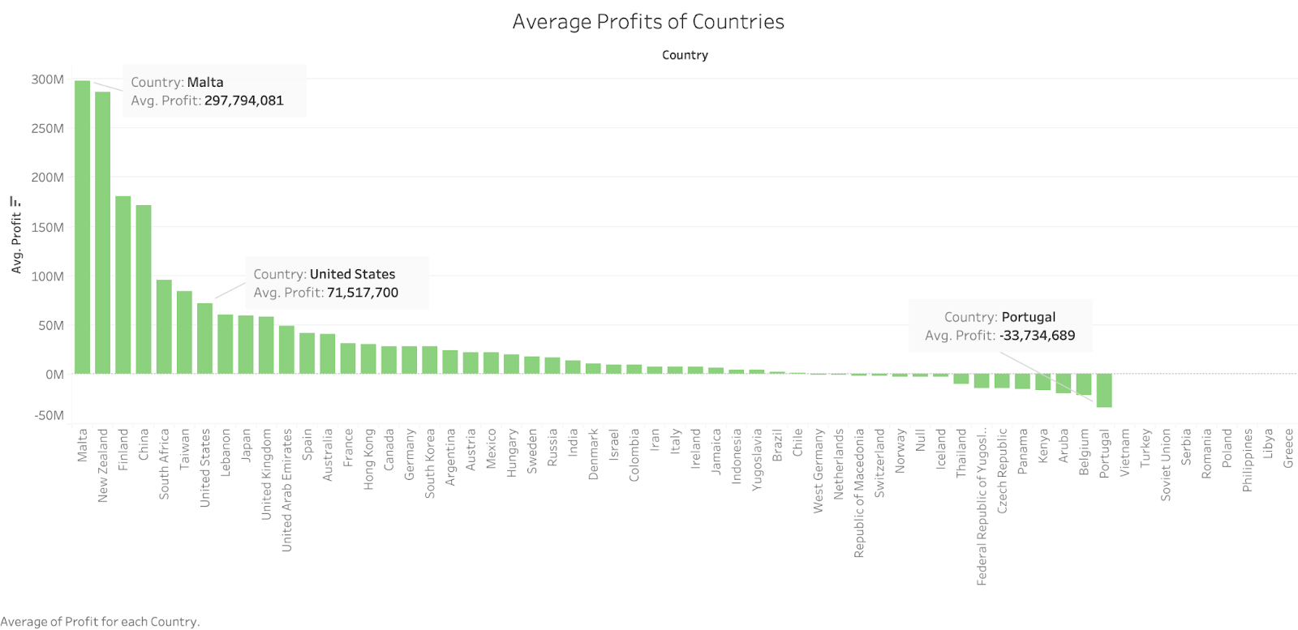
Final visualization
Average Profit of Countries
Malta takes the top result and the United States is now the seventh rank. China and New Zealand both remain in the top five rankings of countries between total and average profit

Slide 15
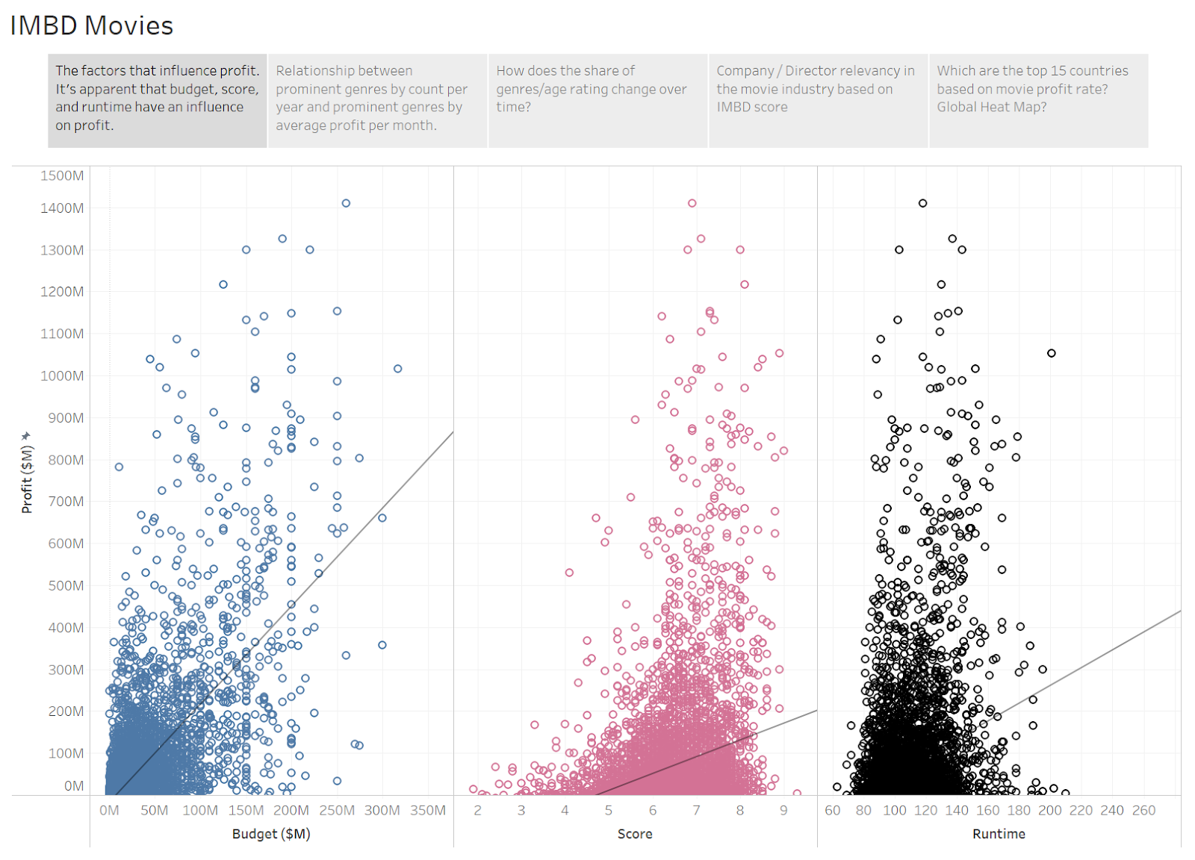
story
Story Board and Key Findings (1)
Profit analysis Scatter Plots
1. Production investment for a movie seems to have some impact on profits. Movies that earned very high profits (over $300M) range from budgets $5M to $317M. This means that factors, other than budget, also impact a film’s profitability.
2. Most profitable movies are concentrated between an IMDb user rating from 6 to 9. But so are low profit movies. High rated movies on IMDb could be strongly correlated with profits.
3. A movie runtime of 80-160 mins apparently attracts most sales. But even low profit movies are clustered around this runtime range. The trend line is stronger than IMDb score but weaker than Budget.
All 3 variables display a relationship with profits, but none seem to be causal in nature. Other factors probably impact business as well.

Slide 16
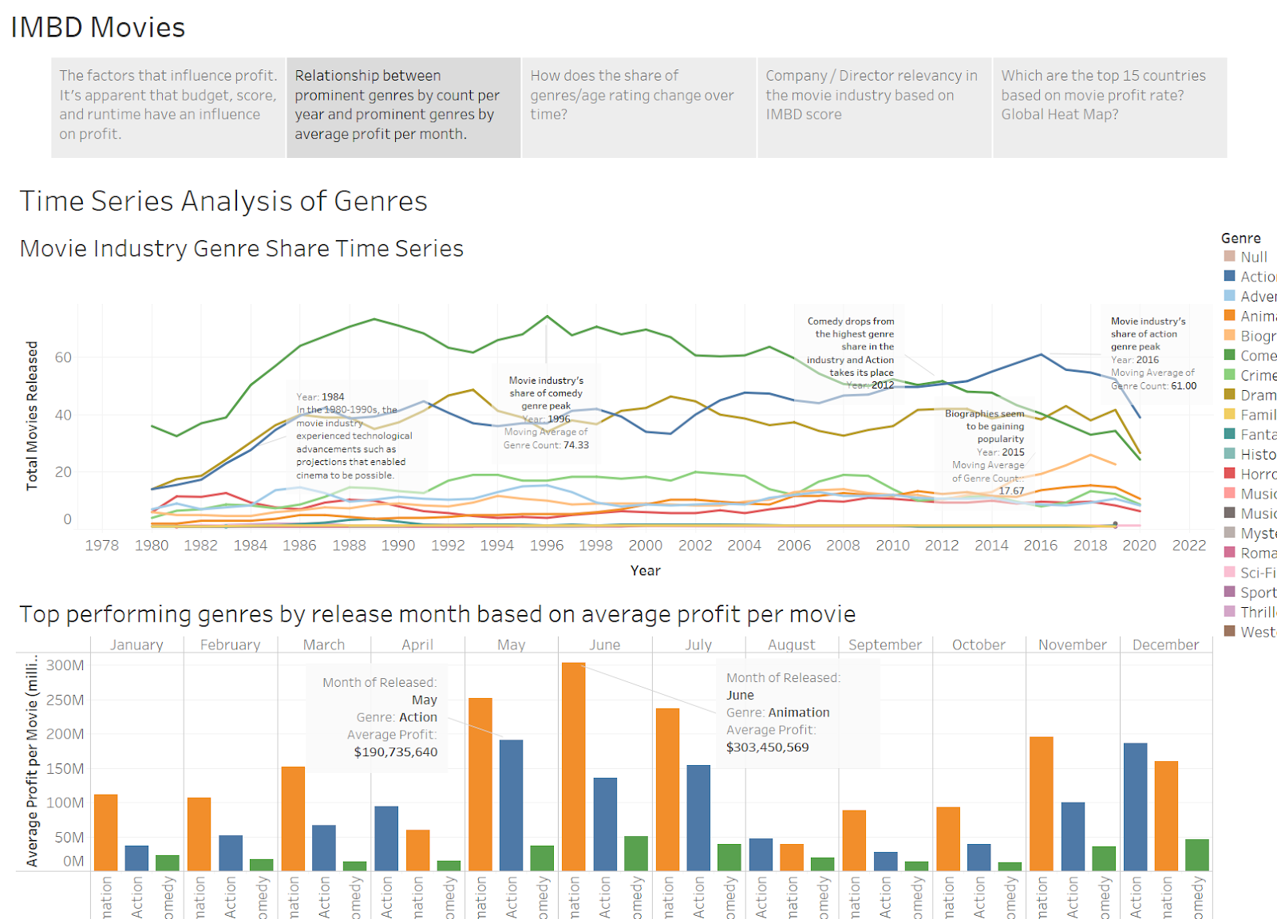
story
Story Board and Key Findings (2)
Time Series Analysis of Genres:
Comedy and Action are the top two Genres of the Movie Industry, with Drama coming in third.
Animation is ranked far lower.
Top Performing Genres by Release Month Based on Average Profit per Movie:
Animation is the top genre based on highest average profits per movie.
The genre is most prominent in May-July, which could be due to summer vacations at educational institutions.
Action and Comedy are the next two top genres by the same measure.
Dashboard Insights:
Although Comedy and Action lead the movie industry as top genres, they do not lead in Average Profits.
Animation generally has the highest Average Profits per month, with Action coming in second and Comedy in third.

Slide 17
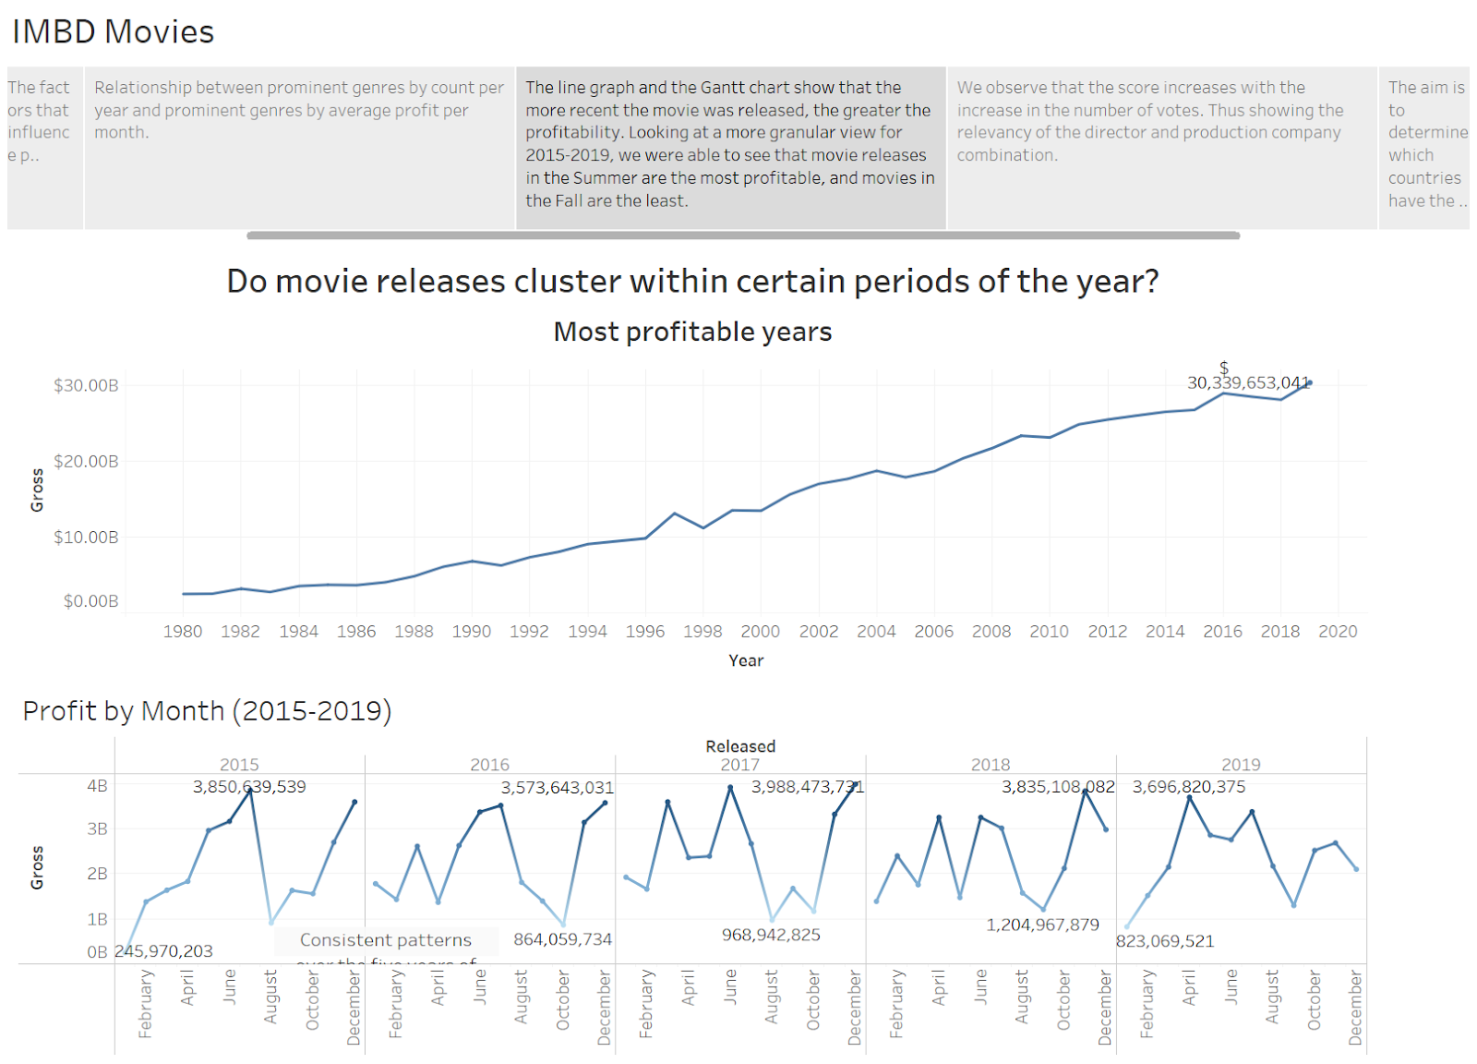
story
Story Board and Key Findings (3)
Most Profitable years
Comparing revenue based on year released is not the best indicator to tell whether movies cluster during certain periods. It’s evident that movies that have released more movies have a higher profit. The yearly rate of movies being released has also increased since 1980.
Profit by Month (2015-2019)
After looking at the common patterns within 2015-2019, the Summer and Winter are the seasons with the most movies released, also making them the most profitable. Meanwhile 2019 is the year with the highest overall profit in the line graph, 2017 had the highest number of movies released and had the highest earning point in the five years.

Slide 18
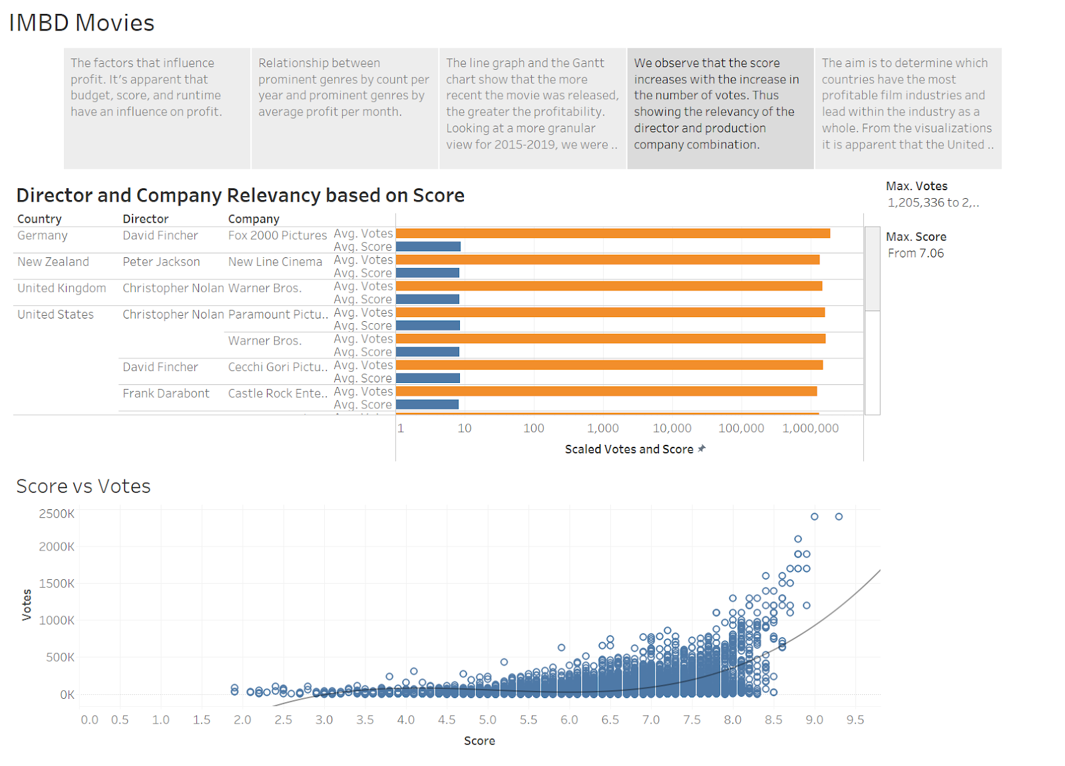
story
Story Board and Key Findings (4)
Director and Company Relevancy
We find that directors and production companies in the USA receive more votes than films do in the non-US countries.
These findings suggest that there is both a language bias and a temporal bias in the distribution of user votes in IMDb.
This tells us that the movies released in the country of the US have the most popularity compared to movies released in non-US groups.

Slide 19
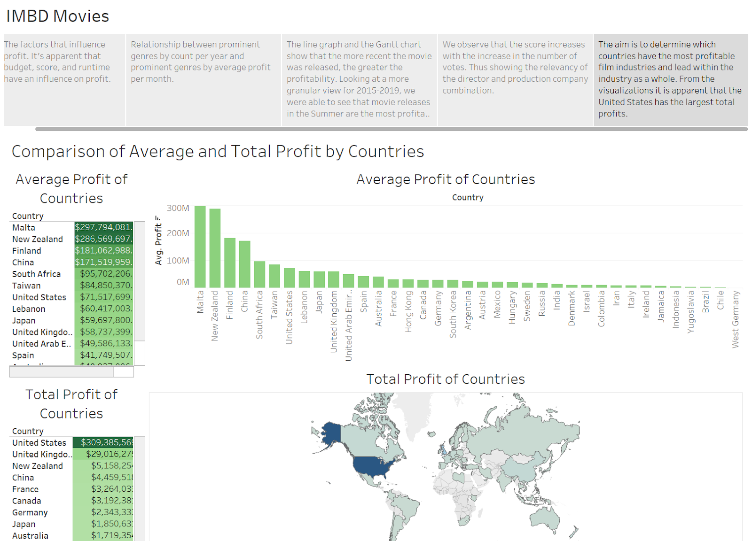
story
Story Board and Key Findings (5)
Most Profitable Country
Seen in the table and global map it is apparent that the United States had the largest film industry of all the countries for the total profit. It is surprising that Malta has the highest average profit for the industry, however, this is mainly due to only one movie from the country. It is insightful to see that for the total profits of countries there is a great spread between the regions of where these countries are located.

Slide 20
System evaluation
Limitations, Possible Extensions & Improvements
Limitations
The dataset utilized displayed elements of data bias towards certain countries and did not display movies from every country. For example, India should display a much larger film industry then the data revealed. IMDB as well as the dataset require further efforts to reduce further bias within the data analysis. Additionally, 2020 only contained partial data and lacked all of the movies from the year.
Possible Extensions and Improvements
IMDB could be web-scraped directly for more variables and detailed analysis to look at new trends and influences of the film industry. For instance, attempting to see the impact of COVID on the film industry with a larger dataset including 2020-2021. It would be insightful to continue at a greater depth with outside data manipulation and analysis to create future projections within the film industry. This projection data could then be used to visualize future trends and where the industry is heading.

Slide 21


Thank You!

